Slide 1
Cloud Computing in eHealth
Nate Bachmeier
TIM-8101: Principals of Computer Science
April 21st, 2019

Slide 2
Why Cloud Computing?
It is …
Standardized Platform for Provisioning Resources
Scalable and Elastic
Always On / Always Available Networking
Reusable set of language independent primitives
It enables …
Cost savings by economies of scale
Provide services anywhere that has network access
Virtually unlimited resources for any business challenge
Notes:
Cloud Computing provides a standardized way to provision resources, such as storage and compute. These resources are always on and always connected which is great for many business challenges.
Industries such as ehealth can use cloud computing to reduce costs through elastic resource scenarios. For example the billing portal can scale to multiple instances during the day, and contract to a minimal set during the night when most of the customers are asleep.
Another key advantage of cloud computing is the ability to provision resources at virtually any scale. Traditional IT systems required planning and lead time to procure these resources. Instead cloud based solutions can use just in time provisioning to have the desired resources as they are needed.

Slide 3
Consuming Clouds
Private Cloud
Standardized Processes within a data center
Hybrid Cloud
Private cloud which extends into public cloud
Public Cloud
Hardware resources are managed completely by third party
Notes:
A solution does not need to be hosted in Azure or AWS in order to be considered a cloud. Some organizations have invested heavily in their own private data centers or want to retain complete control over every bit. Platforms such as OpenStack or Azure Stack provide a control plane and allow for consistent provisioning of elastic resources on customer owned hardware.
Many private clouds have a need to extend into the public cloud in what are called hybrid clouds. For example a mission critical database might have a replica maintained in the public cloud. If the physical server has issues, then the operations team can fail over to the replica and maintain service continuity. After resolving the scenario usage can be transitioned back to the private server.
Public clouds data centers owned by third parties such as Azure or AWS.

Slide 4
Data in the Public Cloud
HIPAA/HITECH Compliance
Tiered Archival Models
Hot
Warm
Cold/Deep Freeze
Protecting Storage
Encrypted Storage
Vaulted Storage
Requirements for PHI
Public clouds are certified
Authorization Policies
Notes:
While that sounds great, as an ehealth provider I need to be concerned with safety of my data. After all there are regulatory requirements around personal health information.
Major public cloud providers such as AWS and Azure are certified as HIPAA and HITECH data compliant, which means that health information can be stored on their platforms.
These CSPs provide features to protect the data such as encryption in transit and at rest. There is also object level permissions that control authorization of individual files usage.
To further help businesses meet compliance requirements there is also a notion of vaulted storage. A storage vault is created with certain policy, such as cannot be modified or deleted for 7 years. After the vault is created the platform will enforce that policy on behalf of the customer.
A key advantage of hosting data in the cloud is storage tiering. For example a patient that will be in surgery later that day can have their records replicated to multiple physical locations. Then if a data center was taken offline the medical professionals would still have access to the information.
If the records are unlikely to be referenced they can be transitioned to cold storage, similar to tape archives, which is highly durable but may have delays before it is available.

Slide 5

Securing Data in Public Clouds
IAM Policy and Federated Identity
Auditing and Logging Services
Certificate Services and Hardware Encryption
Direct Connect, IPSec+VPN, and VPC-to-VPC Peering
Notes:
Authenticate and Authorize
Resources provisioned within a public cloud can be protected with Identity Access Management (IAM) policy. This allows administrators to specify which actions users, groups, or service roles can perform.
Users and groups can originate from corporate directory services and then be federated into the cloud. Federated identities bridges the corporate and cloud environments with single sign-on scenarios.
Audit
The actions of users can be centrally logged for auditing and compliance purposes. Many managed services also support emitting events, which can be connected to Function as a Service (FaaS). These functions can provide real time reactionary policy to predefined behaviors. For instance the security team can be notified by email when a new user joins the administrative group.
Certificate as a Service and Encryption as a Service
Public cloud providers expose services for managing the complexities of encryption and certificates. This lowers the barrier of entry and enables more customers to leverage these technologies.
Attack Surface Reduction
Resources deployed to the public cloud do not need to be publicly available. They can be provisioned on private subnets which can only be accessed from VPN connections. Those VPN endpoints can be further protected by limiting the IP ranges that can be used. For example if the business is located in Europe, they might want to prevent American or Chinese users from even contacting the endpoint.

Slide 6
Common Challenges
Too Broad of Scope
Too Much Tech Debt
Insufficient Maintenance
Cultural Barriers
User Acceptance
Notes:
Too Broad of Scope
Building an ehealth system is a complex task and system designers need to identify multiple release strategies to roll out the platform.
Too Much Tech Debt
Building a system that works with every legacy provider can overwhelm the design team. Organizations need to be prioritize which legacy services will be supported out of the box.
It is also helpful to have a extensibility model so that third party service providers can own some of those integrations.
Insufficient Maintenance
After the system it built there are continuing costs to keep the system operational. Along with defects in the system the infrastructure needs to be well maintained.
In addition to hardware there needs to be enough qualified personal to operationalize the ehealth data.
Cultural Barriers
For the system to be successful it needs to align with the religious and ethical desires of the supported community. When this does not happen it will not be used and its potential unrealized.
User Acceptance
The tooling needs to be cognizant of the needs for the end users and align with their preferences. If the system is convoluted or does not carry political favor with the senior leadership it will not be a successful project.

Slide 7
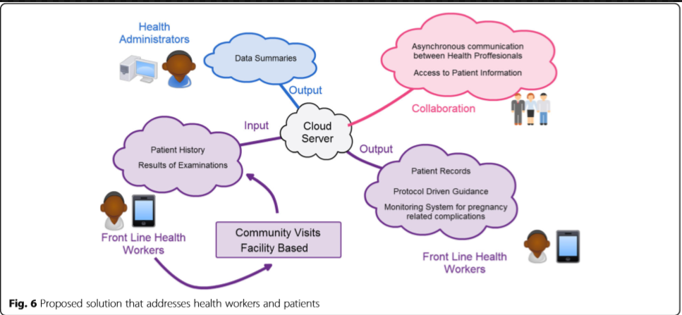
Enabling eHealth in Ghana…
Remote rural locations
Minimal Standardization
High mortality rates
Substandard care
Notes:
Ghana provides an example where ehealth has improved the quality of live for the inhabitants.
Across the rural nation there was minimum standards and substandard care. For instance the treatment given from one doctor to another varied and was not always evidence based. This maternal mortality rates 20x higher than in America.
An ehealth system was created to manage the EHR information and promote collaboration on patient information. This lead to more consensus on the right treatments, resulting in the right decision more often.

Slide 8
Future of eHealth and Cloud Computing
IoT as a Service
ML as a Service
Notification Services
Notes:
As EMR and EHR systems continue to move into the cloud it will expand their capabilities in many dimensions.
IoT as a Service
Large sensor networks attached to patients will provide an influx of information that will enhance existing EMR profiles.
Currently a doctor will only see a patient a few times a year, instead IoT will give them the ability to have more continuous telemetry.
ML as a Service
With the influx of patient data medical professionals will need to turn to machine learning algorithms to unlock patterns contained within it.
Using MLaaS the barrier to entry will be reduced allowing more ideas to rapidly be tested.
Notification Services
Better integration between mobile devices and medical systems will distribute the insights from MLaaS to the end users.
This will lead to shorter wait times and a healthier population between doctor visits.

